Slide 1
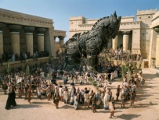
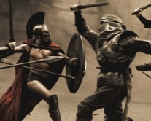

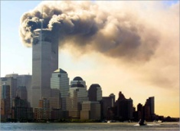

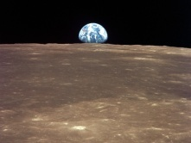
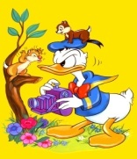
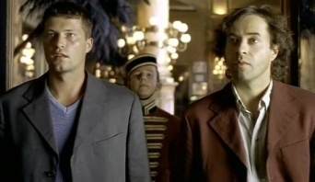
Historical film
Cinema film of recent events
Full length film in a cinema programmer
Epic film
War film
Film made by photographing a series of drawings
Documentary
Film depicting historic events of the past on a grand scale
Newsreel
Film of popular science events
Popular-science film
Film dealing with real events in history
Animated cartoon
Film showing some aspect of human and social activity
Feature film
Film about war

Slide 2



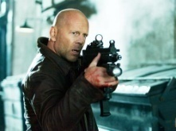
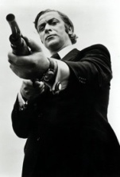



Film about criminals
Comedy
Women's film that moves one tears
Musical
Drama of light and amusing character typically with a happy end
Tearjerker
Film that inspires horror and fear
Thriller
Film consisting of musical numbers and dialogue that develop the plot of an underlying story
Gangster film
Horror
Film of serious or solemn kind with a sad end
Film that makes one experience a sudden sharp feeling of excitement
Special agent film
Tragedy
Film about spies, detectives

Slide 3
Vocabulary and speaking
Summing up
Each person has a preference for this or that type of films.
What films do you like watching?
What kind of films don’t you like?
When can we say the film is worth seeing?
Can you explain what films you like best and why?

